Slide 1

Domain: MATLAB
Technology: COMMUNICATION
EEG SIGNAL PROCESSING AND EMOTION RECOGNITION USING CONVOLUTIONAL NEURAL NETWORK

Slide 2
Index
Abstract
Introduction
Literature review
Existing Method
Disadvantages
Proposed method
Advantages
Applications
Results
Hardware and Software Requirements
References

Slide 3
Abstract
As an important task in the advanced stage of artificial intelligence, the research of emotional EEG has received more and more attention in recent years. In order to improve the accuracy of EEG signal emotion recognition, in this paper, Fast Fourier Transform (FFT) and Continuous Wavelet Transform (CWT) are used to extract the features of EEG signals on the DEAP data set and build two CNN models for emotion recognition. The results show that the proposed algorithm is effective for EEG signal emotion recognition. The average recognition accuracy of emotion valence can reach 75.9%; the arousal can reach 79.3%; the like/dislike can reach 80.7%. This research can provide practical application reference for continuous dimension emotion automatic analysis and machine recognition.
Index Terms: component; EEG; FFT; CWT; CNN; emotion recognition

Slide 4
Introduction:
Enabling human-machine interfaces to interpret emotional states paves the path towards emotionally capable machines that offer more natural interactions and better performance in the fields of rehabilitation robotics, multimedia content characterization, personalized recommender systems etc. Several approaches to emotion detection have been proposed. Characterizing emotional data from facial expressions have been explored. However, such methods may be prone to deception as the associated parameters vary easily, subject to different situations. Use of physiological signals (especially electroencephalogram (EEG)) have gained a lot of interest. Time-frequency domain features such as power spectral density (PSD) and frequency power ratios have been employed with relative success 6,7. Given the non-Guassian nature of EEG signals, it makes sense to explore higher order spectral features. In this paper, we explore derived features of bispectrum for quantification of emotions using a Valence-Arousal emotion model. Classification of emotional states viz. Low/High Arousal (calm/bored to excited/stimulated) and Low/High Valence (unhappy/sad to happy/joyful) have been considered. Classification experiments were performed over EEG signals from the DEAP dataset. The choice of the Valence-Arousal model has been inspired by the circumplex model of affect. Preliminary classification experiments were conducted using EEG pertaining to Fp1 and Fp2 channels. Linear Kernel Least Square Support Vector Machine (LS-SVM) and back-propogation Artificial Neural Networks (ANN) were used. Further experiments were conducted by performing backward sequential feature selection.

Slide 5
Literature review:
S. NO | Journal Type with year | Authors | Title | Outcomes
1 | 84:31-35. | Kumar N, Khaund K, Hazarika S M. | “Bispectral Analysis of EEG for Emotion Recognition” | Studied about . Procedia Computer Science
2 | 30(23):e4446.1-e4446.13 | Liu J, Meng H, Li M, Fan Z, Rui Q, Nandi AK | “Emotion detection from EEG recordings based on supervised and unsupervised dimension reduction.” | Studied about Concurrency and Computation: Practice and Experience, 30
3 | (Apr.1):35-41. | Atkinson J, Campos D. | “Improving BCI-based emotion recognition by combining EEG feature selection and kernel classifiers. ” | Studied about Expert Systems with Applications
4 | AAAI Press, 4746–4752 | Tripathi S, Acharya S, Sharma R D, Mittal S, Bhattacharya S | “using deep and convolutional neural networks for accurate emotion classification on DEAP datase” | Proceedings of the Thirty-First AAAI Conference on Artificial Intelligencewas studied
5 | 35(07): 1674-1680 | Hao C, Yongli L, Weifang L | “Multi-analysis domain feature fusion of EEG emotion recognition based on integrated deep learning model” | Contains every thing related to control and Decision

Slide 6
Existing method:
Emotions recognition Research of human emotional states via physiological signals involves recording and statistical analysis of signals from central and parietal cortex. A popular physiological signal that is highly adopted for human emotion assessment is the EEG, etc. Unlike other physiological signals, EEG is a non-invasive technique with good temporal and acceptable spatial resolution. Thus, EEG might play a major role on detecting an emotion directly from the brain at higher spatial and temporal resolution.

Slide 7
Disadvantages in Existing methods:
One of the biggest disadvantage is increase in computer processing speed.
Increase of computing power.
Accuracy is less.

Slide 8
Proposed method:
Emotion is a psycho-physiological process triggered by conscious and/or unconscious perception of an object or situation and is often associated with mood, temperament, personality and disposition, and motivation. Emotions play an important role in human communication and can be expressed either verbally through emotional vocabulary or by expressing nonverbal cues such as intonation of voice, facial expressions, and gestures. Most of the contemporary human-computer interaction (HCI) systems are deficient in interpreting this information and suffer from the lack of emotional intelligence.
The current data set is recorded with the goal of creating an adaptive music video recommendation system. In our proposed music video recommendation system, a user’s bodily responses will be translated to emotions. The emotions of a user while watching music video clips will help the recommender system to first understand the user’s taste and then to recommend a music clip which matches the user’s current emotion.

Slide 9
Advantages of Proposed method:
1.Power reduction.
2. Computation speed reduces.
3. Increase of accuracy

Slide 10
Applications:
1.industrial control
2.environmental monitoring,
3. military surveillance,
4.intelligent transportation systems and medical field.
5.Furthermore, it can function independently in harsh or high-risk places where human presence is not possible
6.Disaster relief operations.
7.Biodiversity mapping
8.monitoring of temperature, pressure, and humidity.

Slide 11
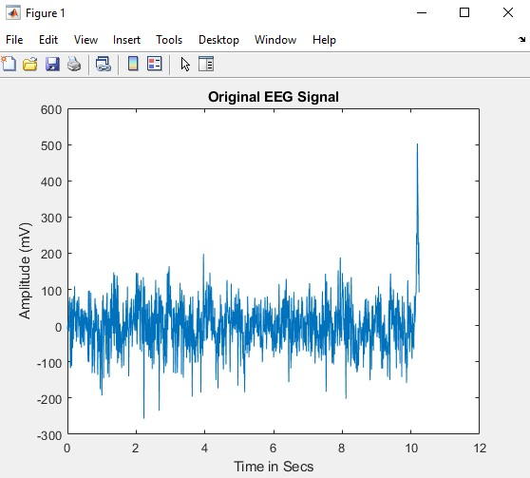
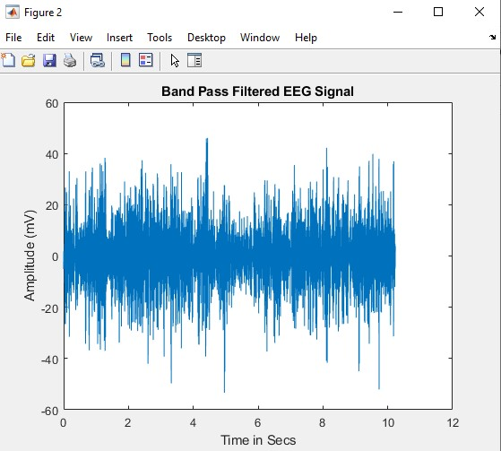
Applications:

Slide 12
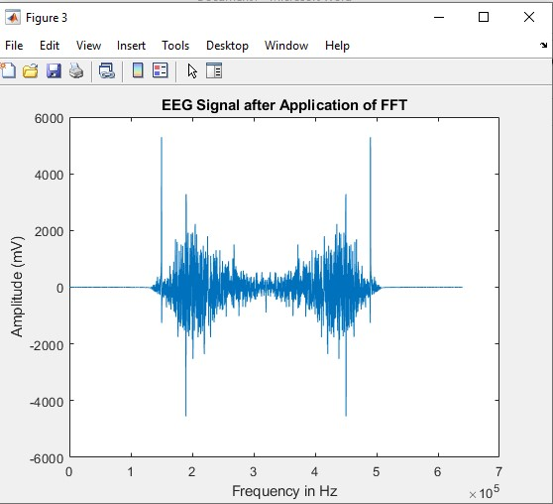
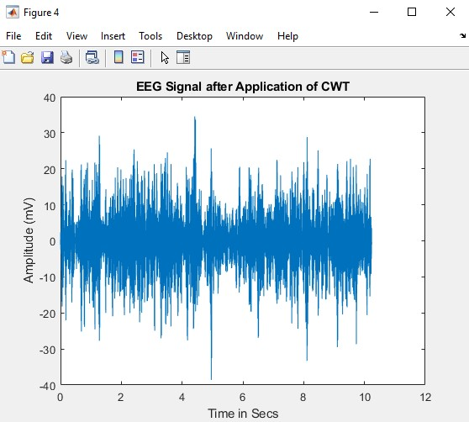
Applications:

Slide 13
Hardware and Software Requirements:
Hardware & Software Requirements:
Software: Matlab R2018a.
Hardware:
Operating Systems:
• Windows 10
• Windows 7 Service Pack 1
• Windows Server 2019
• Windows Server 2016
Processors:
Minimum: Any Intel or AMD x86-64 processor
Recommended: Any Intel or AMD x86-64 processor with four logical cores and AVX2 instruction set support
Disk:
Minimum: 2.9 GB of HDD space for MATLAB only, 5-8 GB for a typical installation
Recommended: An SSD is recommended a full installation of all Math Works products may take up to 29 GB of disk space
RAM:
Minimum: 4 GB
Recommended: 8 GB

Slide 14
References:
[1] Kumar N, Khaund K, Hazarika S M. (2016) Bispectral Analysis of EEG for Emotion Recognition. Procedia Computer Science. 84:31-35.
[2] Liu J, Meng H, Li M, Fan Z, Rui Q, Nandi AK. (2018) Emotion detection from EEG recordings based on supervised and unsupervised dimension reduction. Concurrency and Computation: Practice and Experience, 30(23):e4446.1-e4446.13.
[3] Atkinson J, Campos D. (2016) Improving BCI-based emotion recognition by combining EEG feature selection and kernel classifiers. Expert Systems with Applications, 47(Apr.1):35-41.
[4] Tripathi S, Acharya S, Sharma R D, Mittal S, Bhattacharya S. (2017) Using deep and convolutional neural networks for accurate emotion classification on DEAP dataset. In Proceedings of the Thirty-First AAAI Conference on Artificial Intelligence, AAAI Press, 4746–4752.
[5] Kan W, Li Y, Computer S O. (2019) Emotion recognition from EEG signals by using

